Slide 1


Data Science with Python Career Program – Internship Project
By – PRANAV BANSAL

Slide 2


AGENDA
Data Exploration
Data Insights
EDA Graphs
Graphical Analysis
Insights from Analysis
Data Cleaning and Data Preprocessing steps
ML Modeling
Deployment of ML Models using Streamlit
Conclusion
References

Slide 3

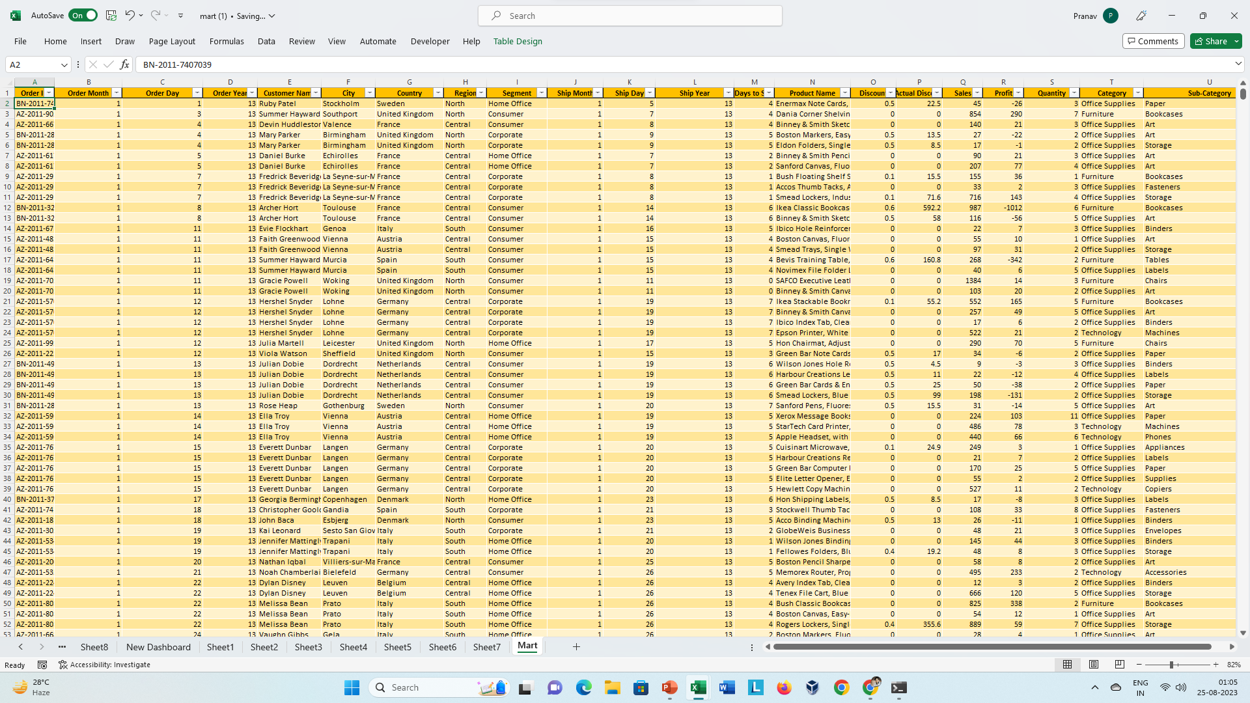
Data Exploration
The Dataset used in this project is the "Amazing Mart" Dataset, which contains the information about different products taken by different customer from different geographical areas for the year 2013 to 2016 with their sales and profits. This data has 8047 rows and 19 features. Features are Order Id, Order Date, Ship Date, Customer name, Product name, Country, City, State, Region, Segment, Ship Mode, Days to ship, Quantity, Discount, Actual Discount, Category, Sub-category, Sales and Profit. In this Dataset we will be applying advanced statistical and machine learning techniques to analyze the data and build a robust model that can accurately predict the sales of the mart .

Slide 4

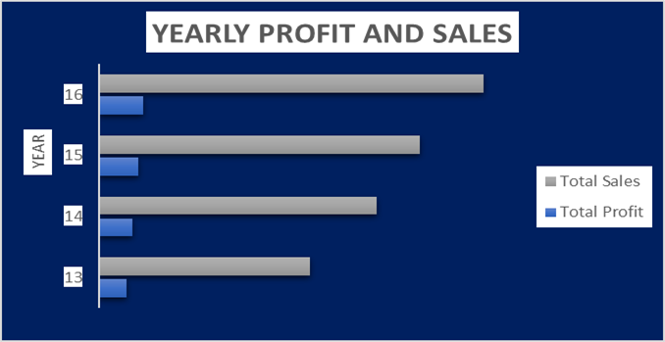
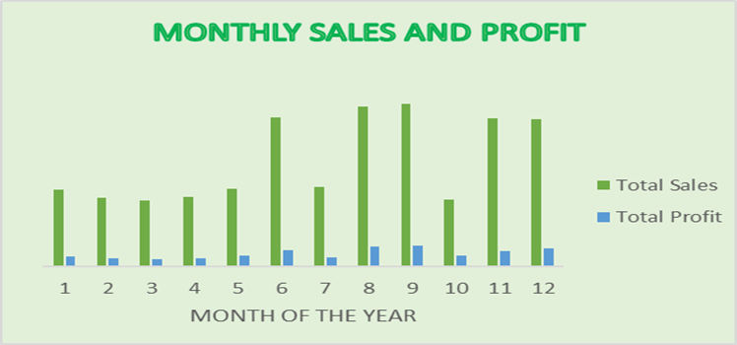
Data Insights
Mart Analysis
Total Sales | 2348361
Total Profit | 283202
Total Quantity | 30348
Total Discount | 885.55
With the passing of the years , the sales is also increasing, Same applies to the profit as well , profit is also increasing every year.
The sales is mostly high in the seasonal months like August, September, November and December. Same goes with the profit.

Slide 5
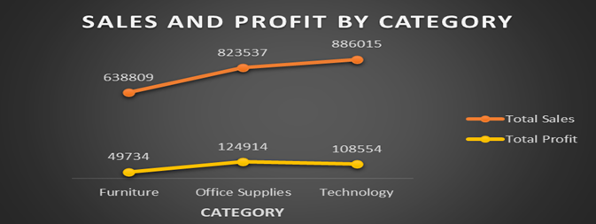
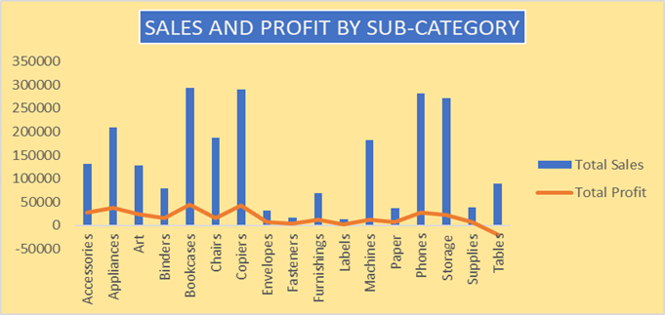
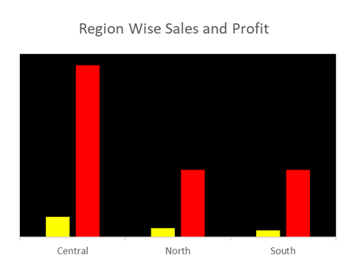
Data Insights
From the above plot we can observe that ‘Technology’ Category has the highest sales. Whereas, In terms of profit Office Supplies has the highest profit. Furniture category have both i.e.. lowest sales and profit.
In the above plot we can see that Bookcases sub-category has the highest sales and profit. Copies and Phones also have good sales and profit. But, Supplies and Tables has loss instead of profit. Sales of Tables is better than other sub-categories but still it is incurring high loss.
From the above plot we can observe that Central Region has the highest sales and profit. North and South have almost equal sales , but the profit in North Region is more than South Region.

Slide 6

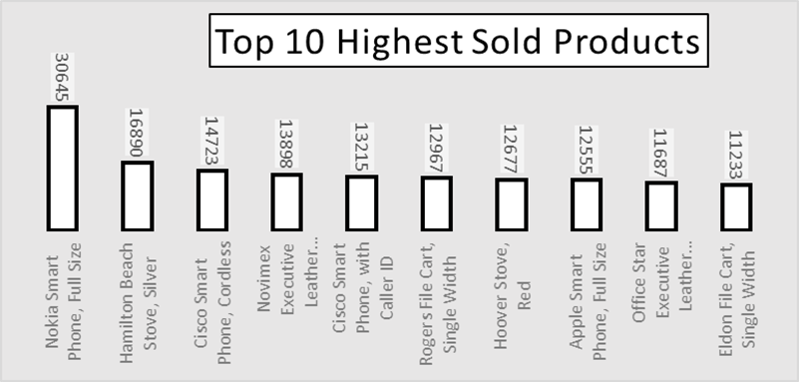
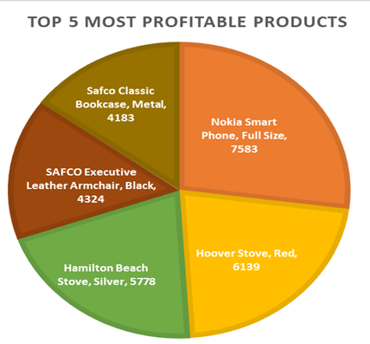
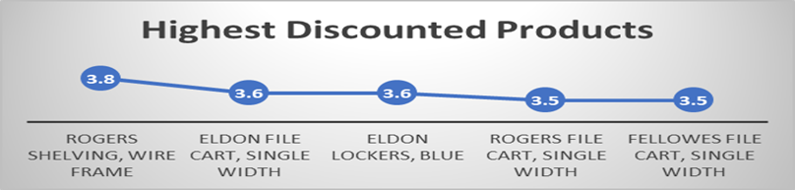
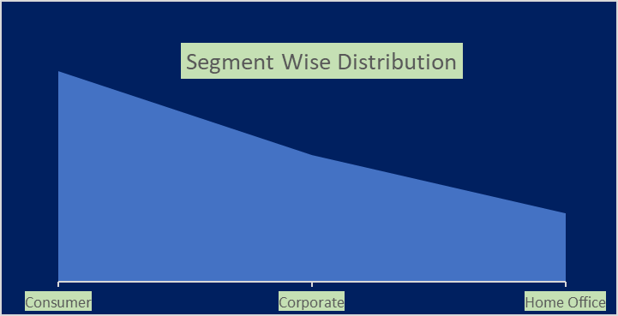
Data Insights
Insights from the Data :
The Most Sold Product is Nokia Smart Phone. It is also the most profitable product.
In terms of highest discount Rogers Shelving, Wire Frame leads in the list.
Findings From this Plot is that most of the customers belongs to Consumer Segment.

Slide 7

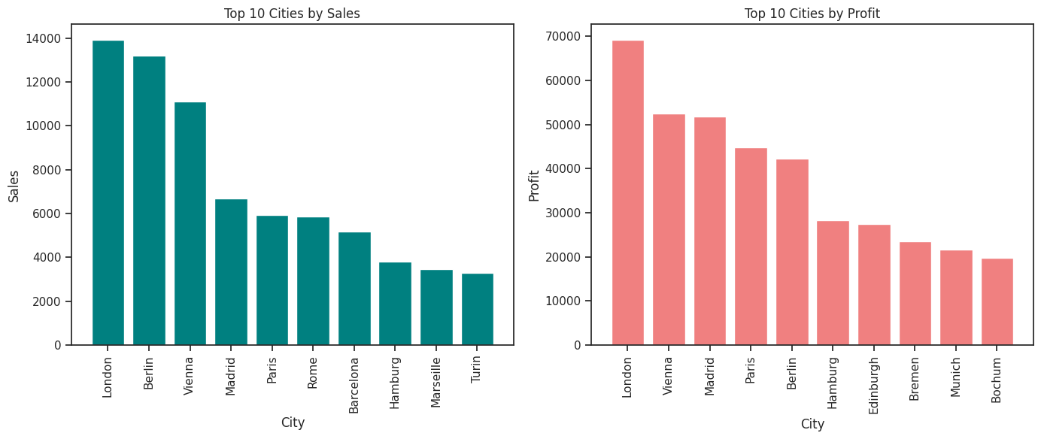
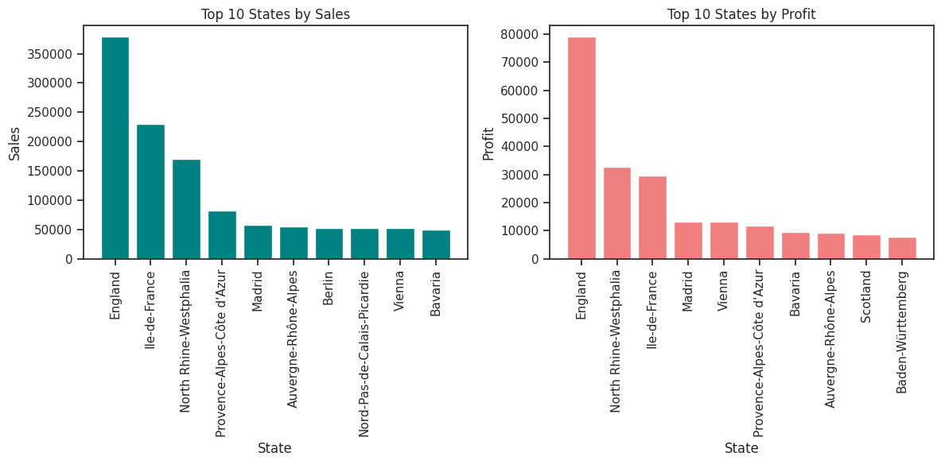
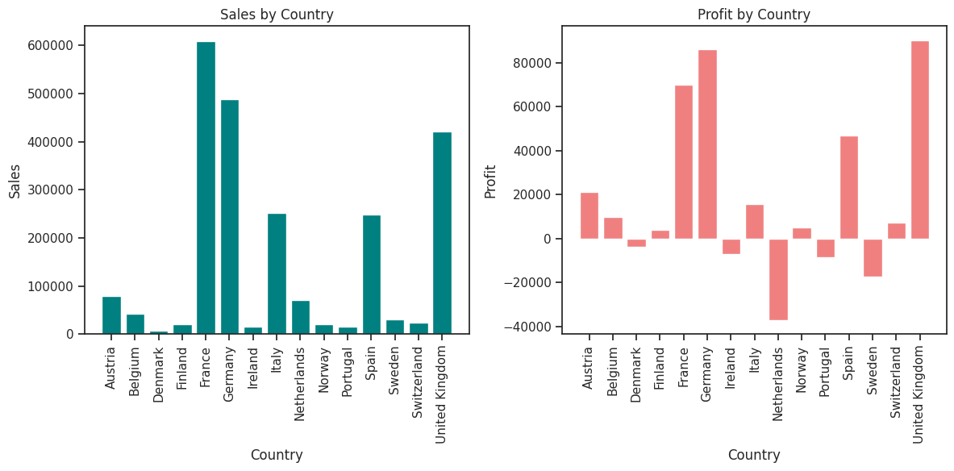
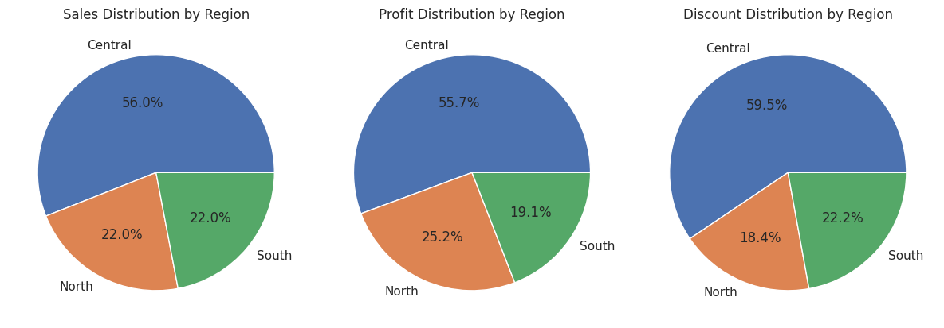
EDA GRAPHS
#Importing libraries
Import numpy as np
Import pandas as pd
Import seaborn as sns
Import matplotlib.pyplot as plt

Slide 8
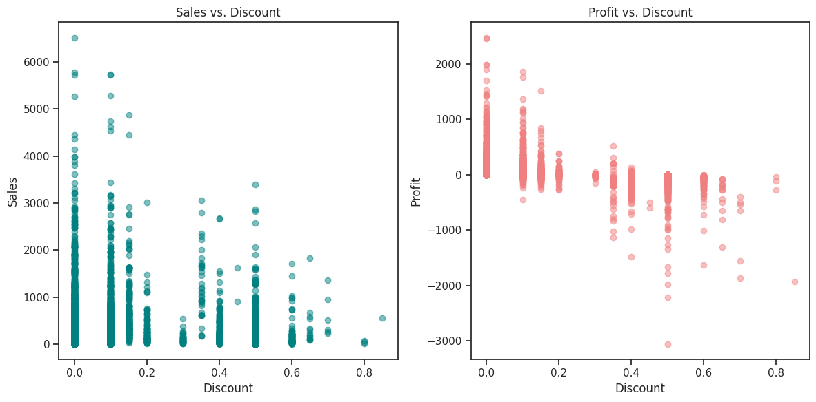
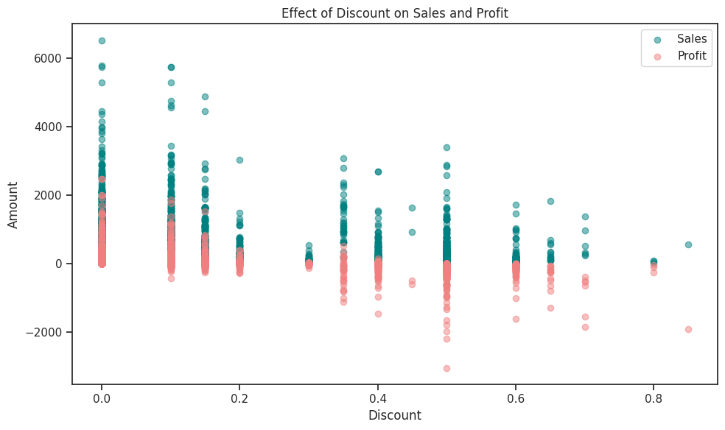
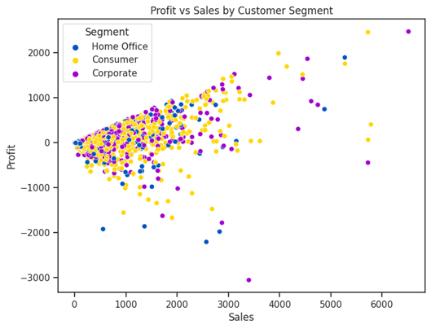
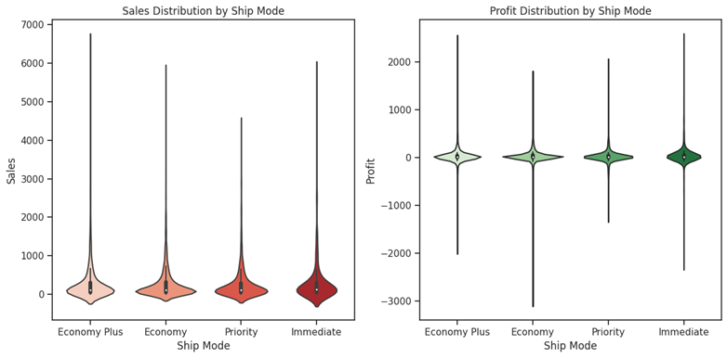
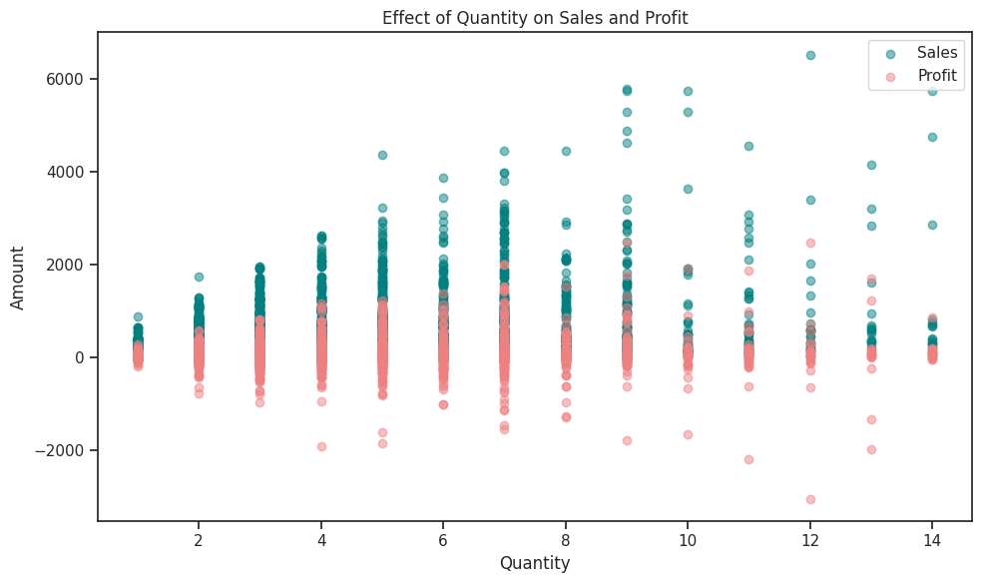
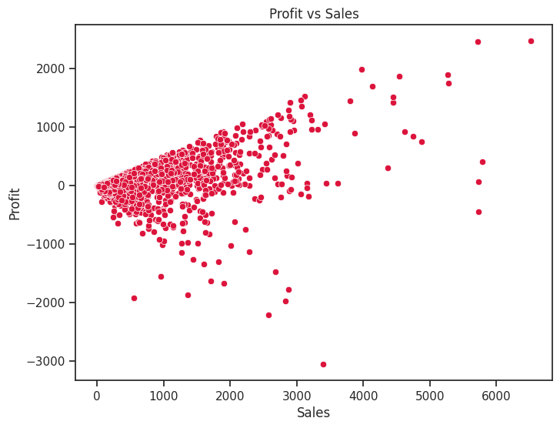
EDA GRAPHS

Slide 9
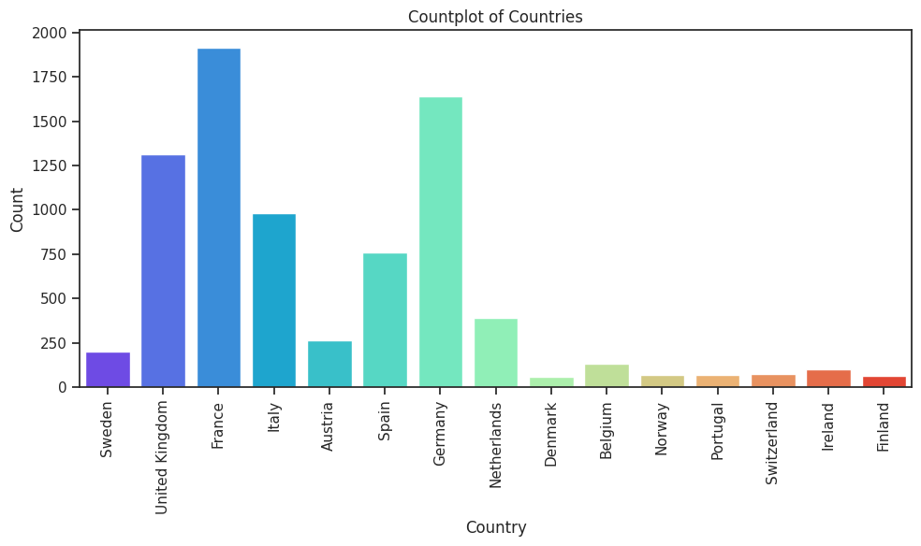
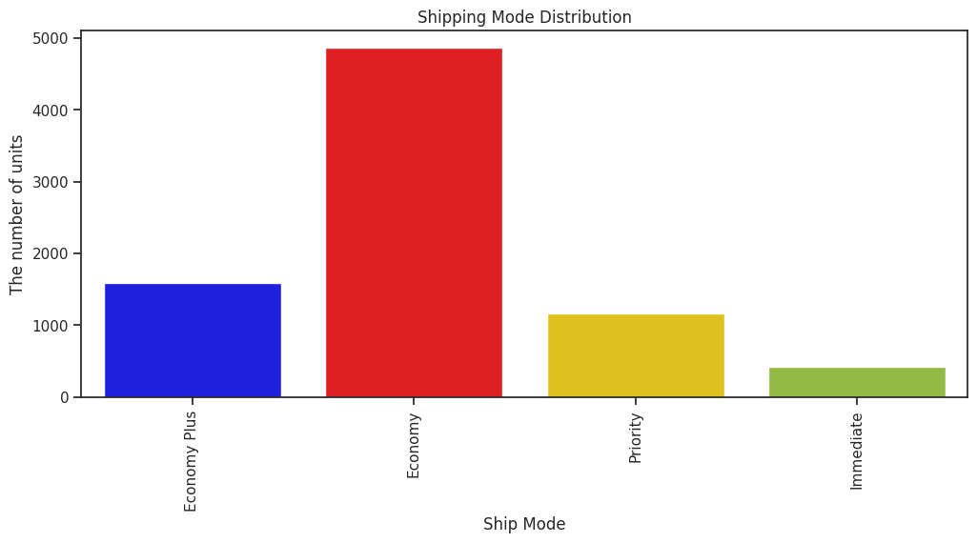
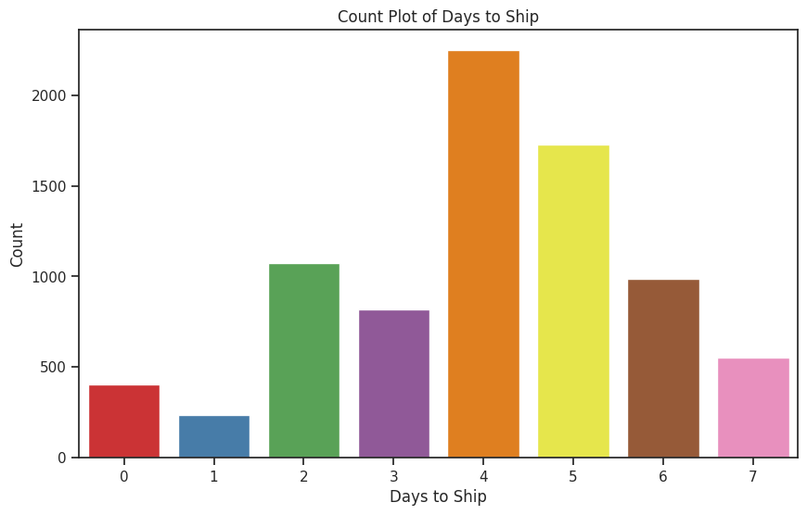
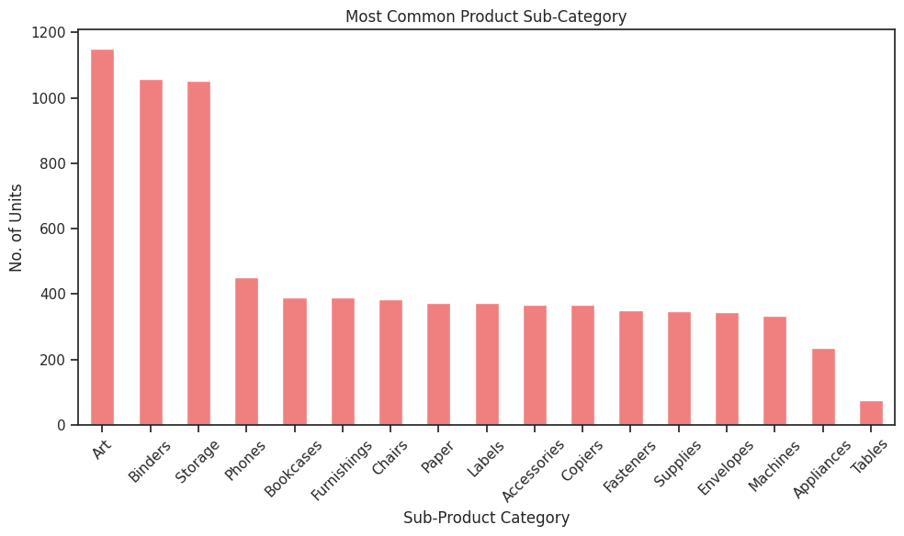
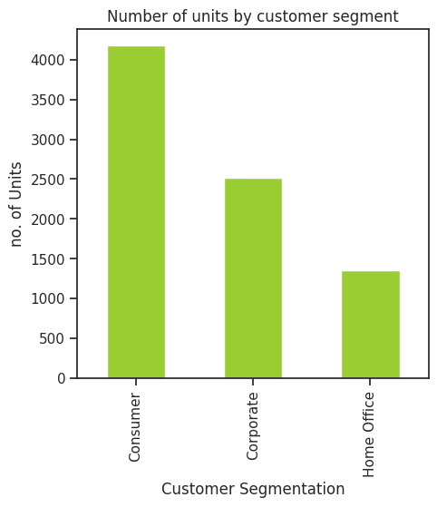
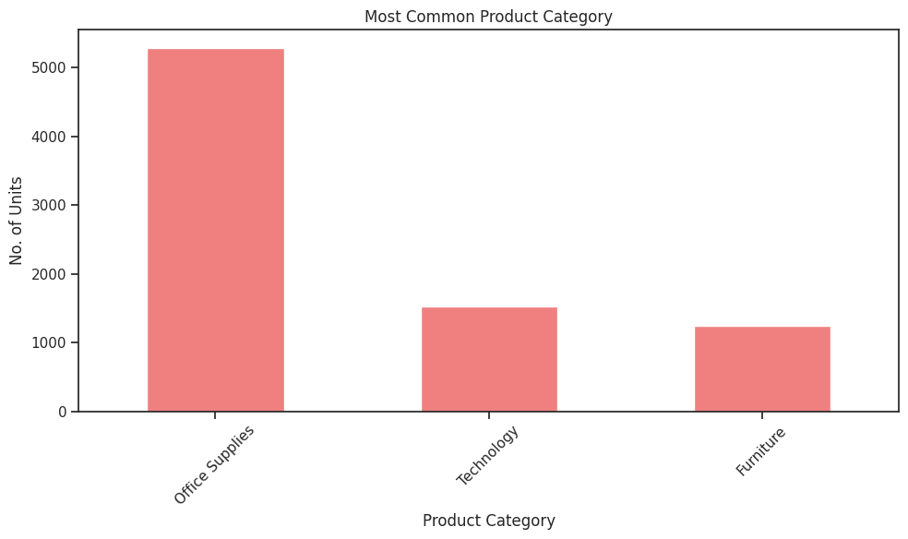
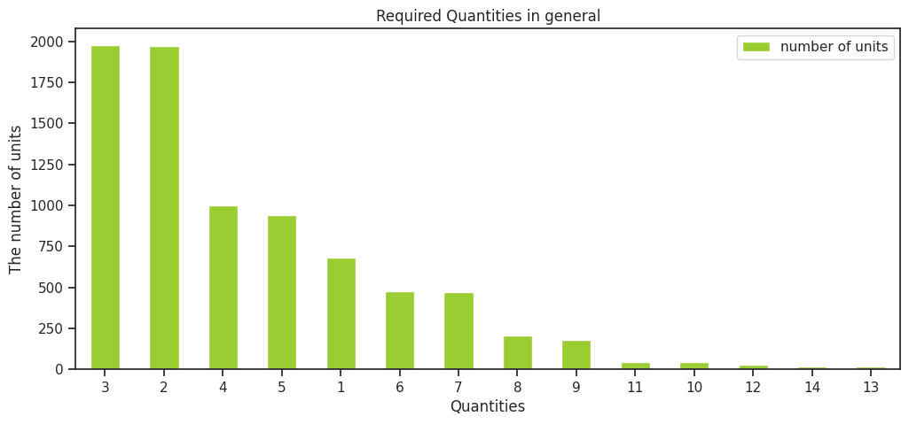
EDA GRAPHS

Slide 10
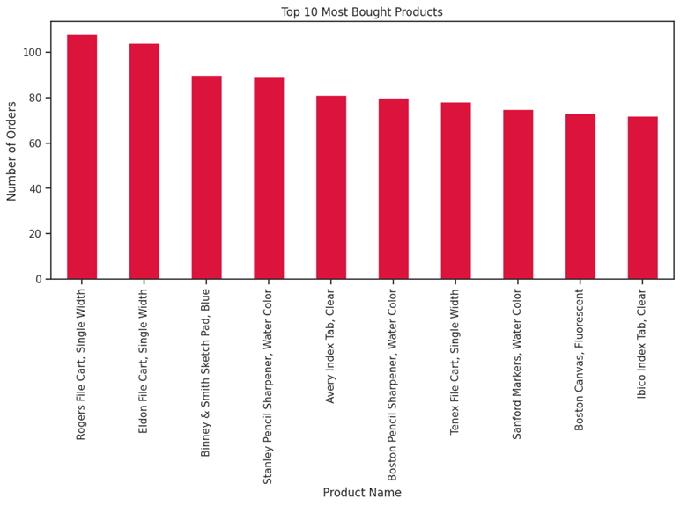
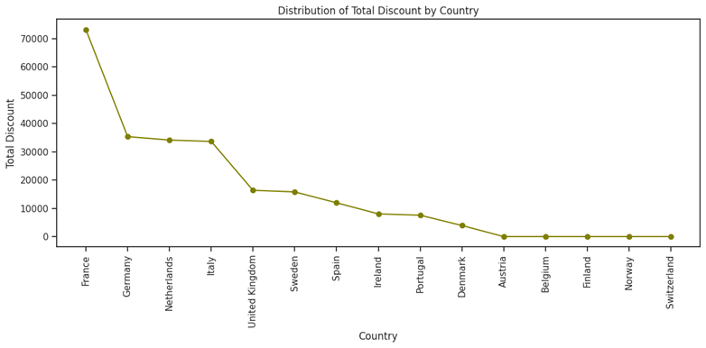
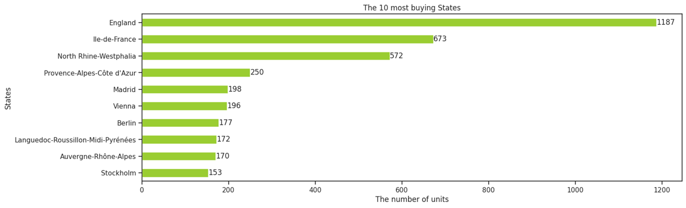
EDA GRAPHS

Slide 11
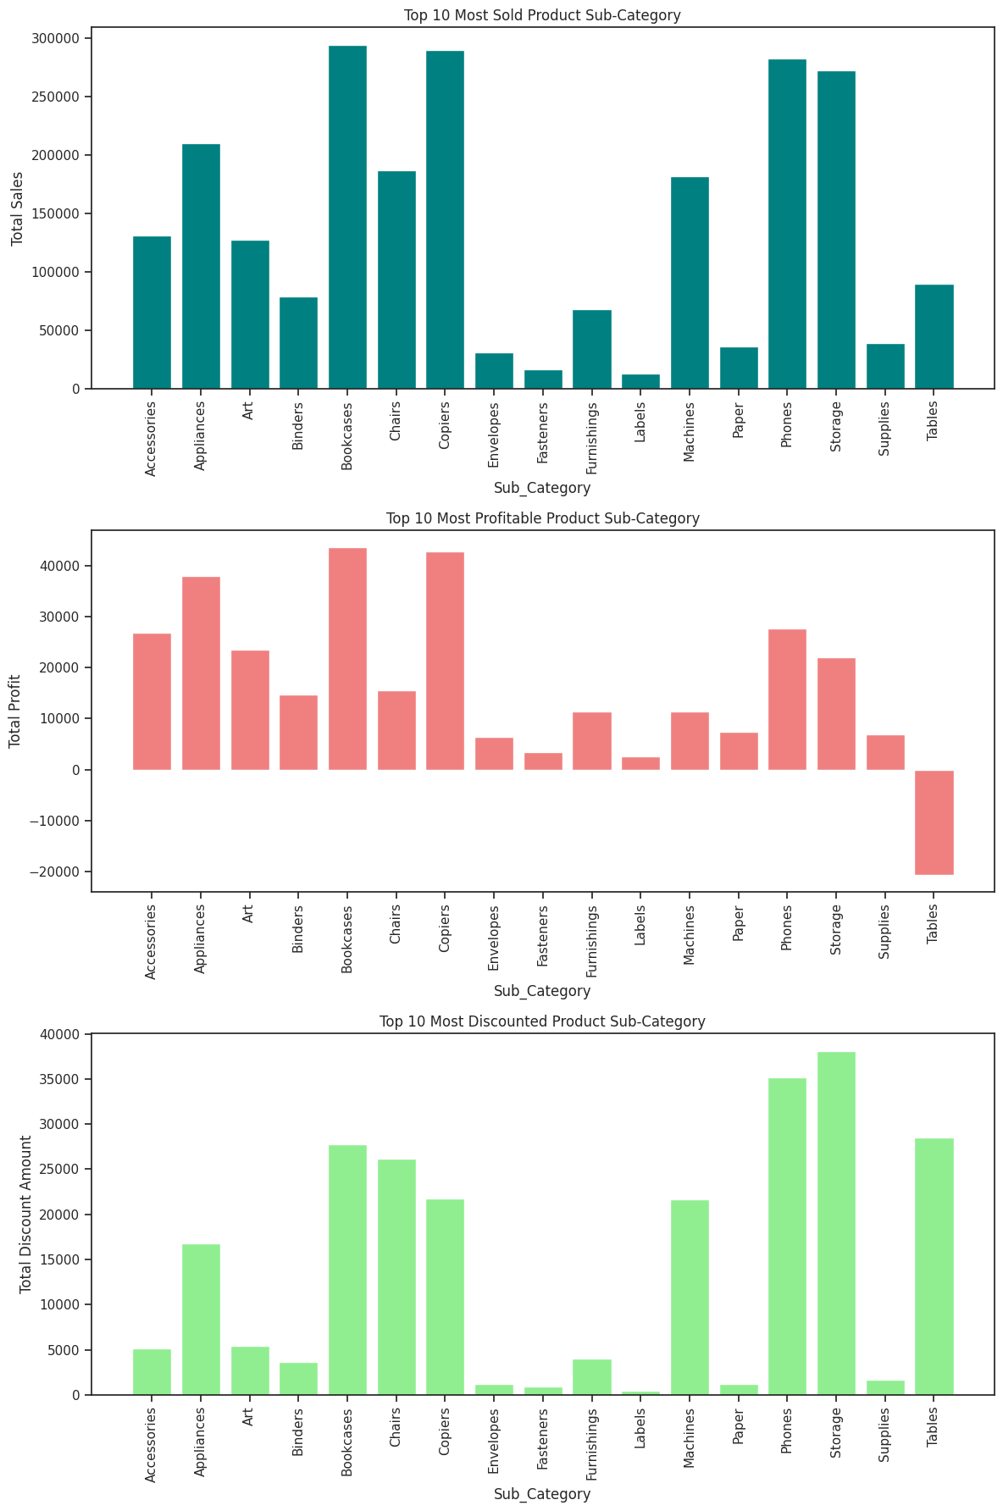
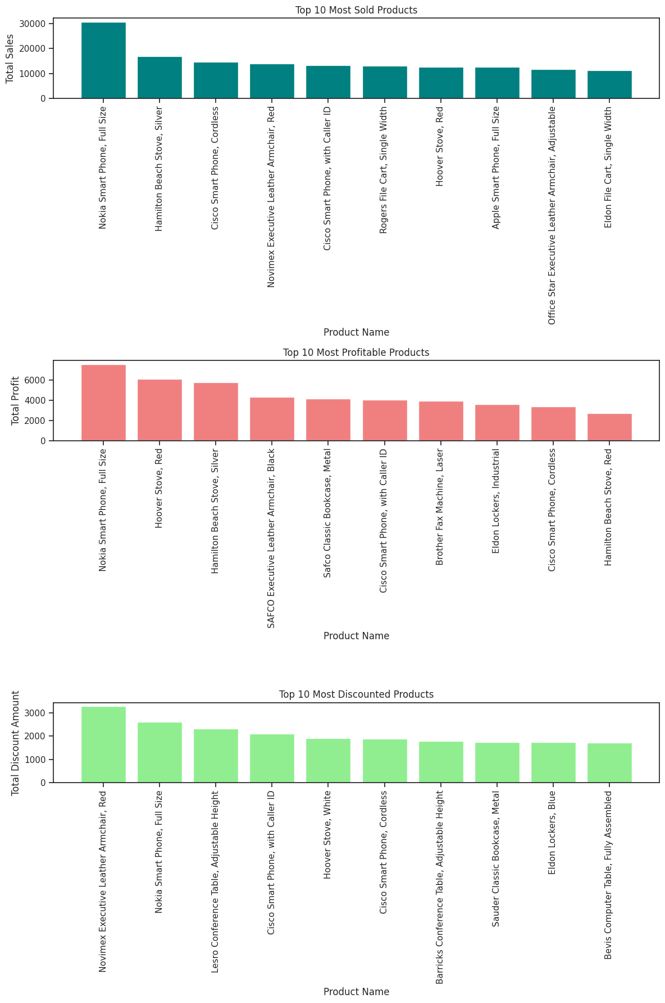
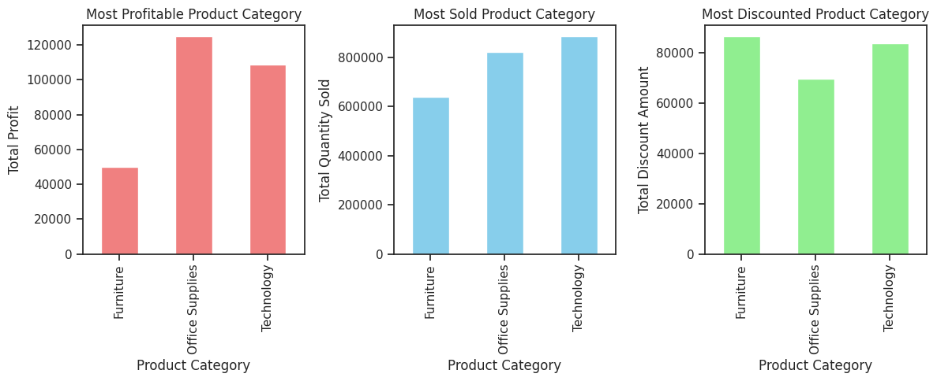
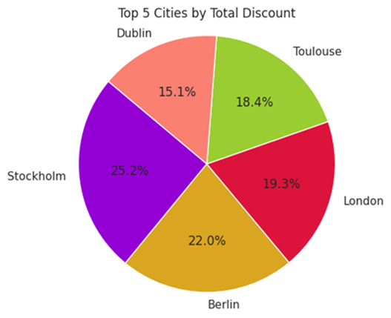
EDA GRAPHS

Slide 12
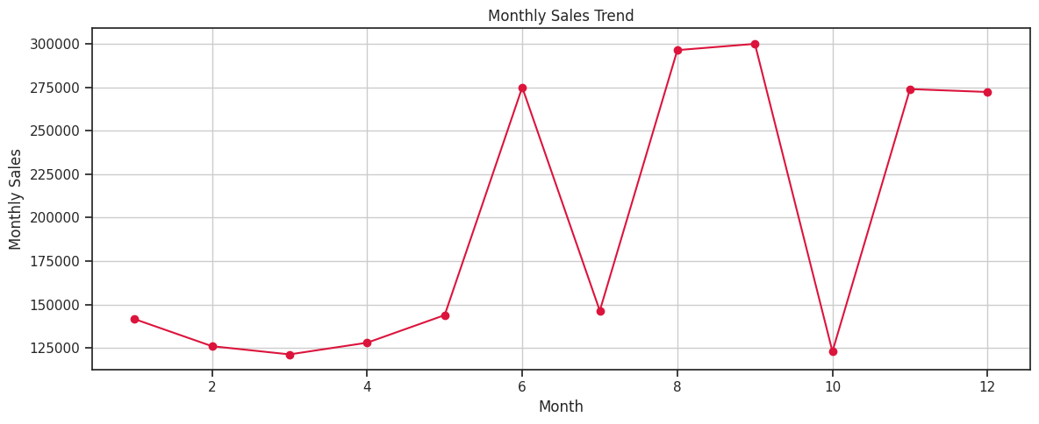
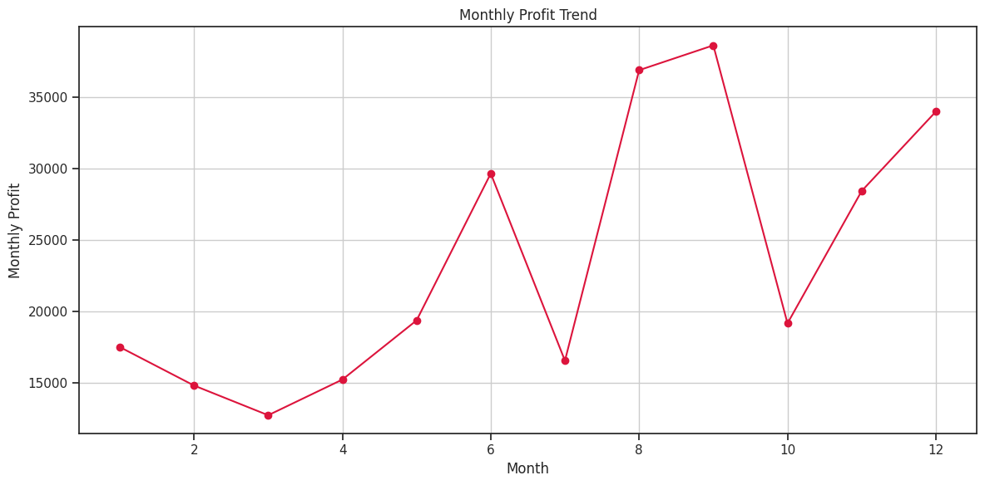
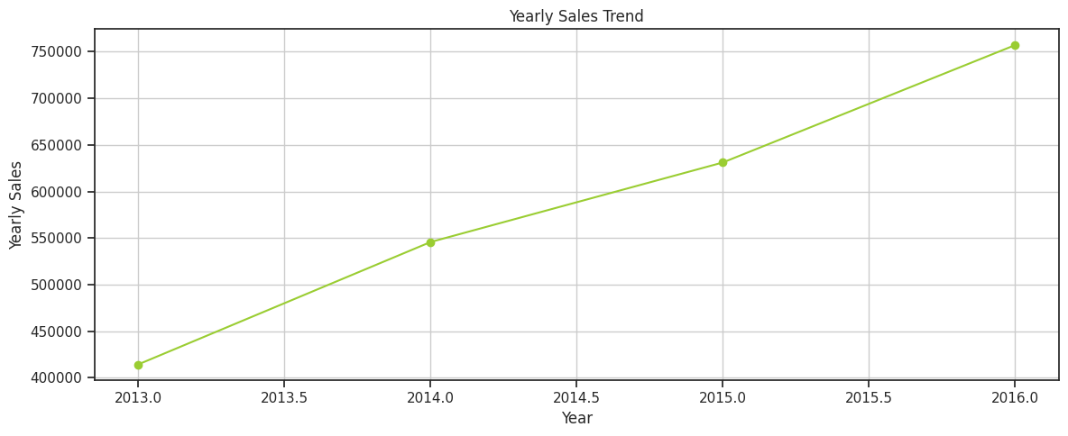
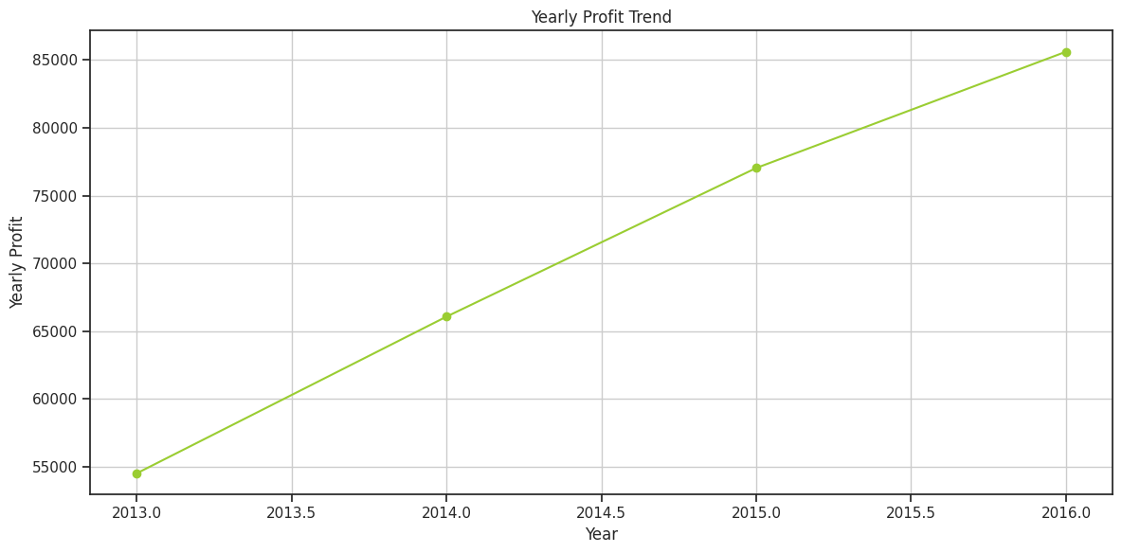
EDA GRAPHS
TIME SERIES ANALYSIS

Slide 13
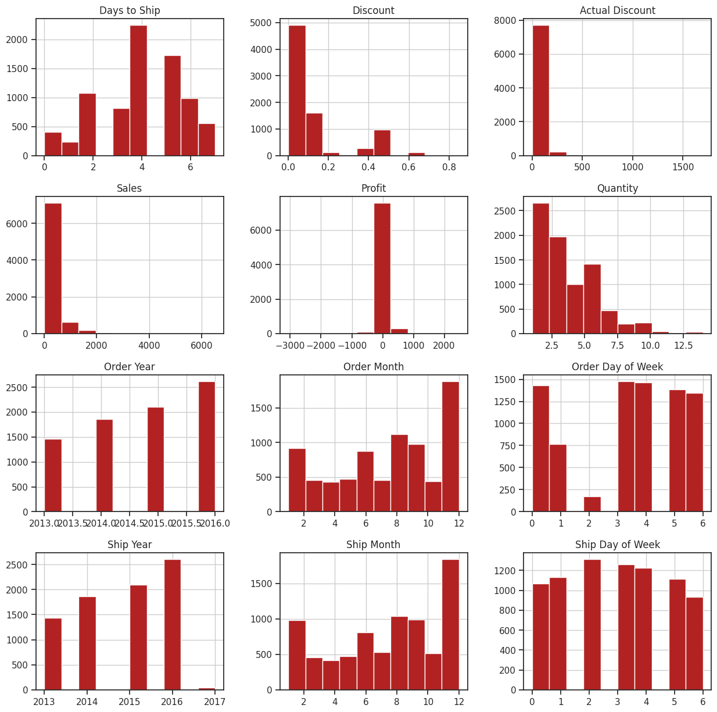
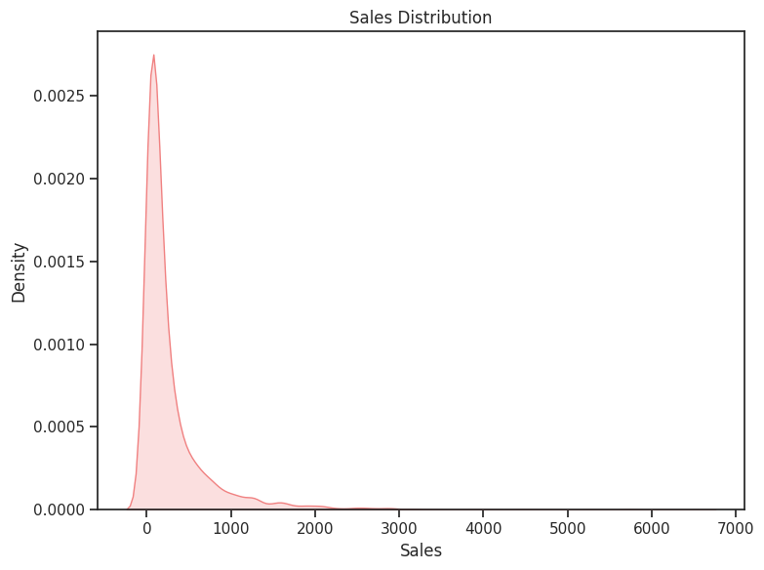
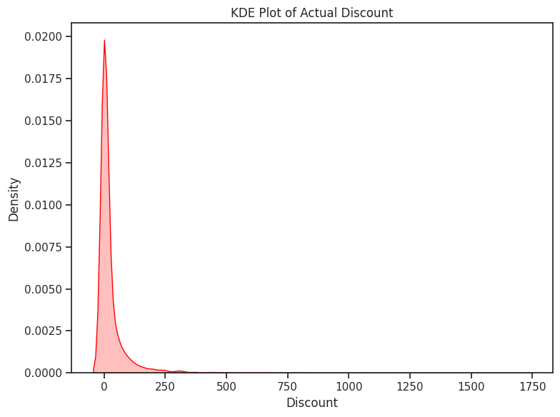
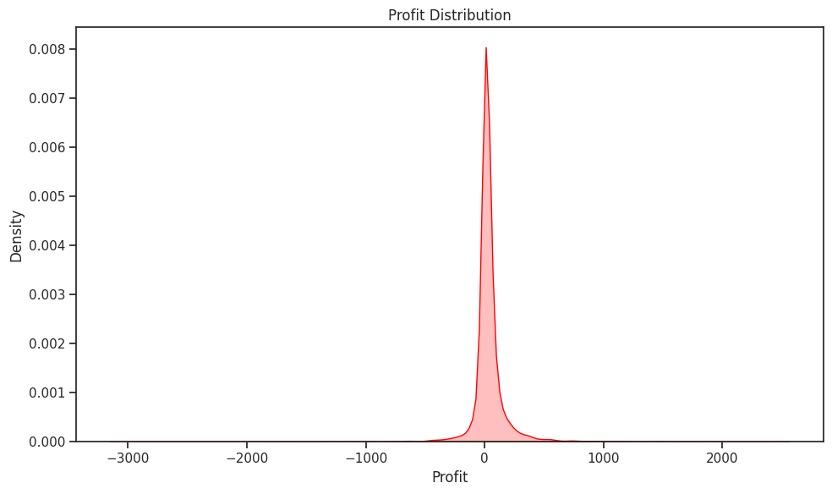
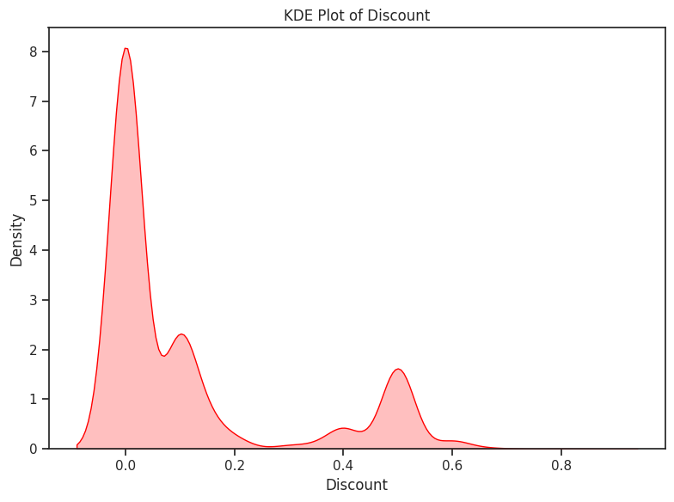
Graphical Analysis

Slide 14

Insights From Analysis
Here I have used the Amazing Mart Dataset. Before applying Visualization , first I updated the dataset like performed some data cleaning, Removal of Outliers and some unnecessary columns and then I visualized the dataset using different visualization techniques(matplotlib and seaborn). I have used various plots in this like Bar plot, Hist plot, Scatterplot, box plot, Line plot and many more. I also used correlation plot (Heatmap) to check the correlation between different features, where I have found that With the increase in the year the sales keeps on increasing , but the profit and actual discount are highly negatively correlated. I have also used pair plot to check the pairwise relationship between different features. In this Exploratory Data Analysis (EDA) step of our project, we gained various insights from the data. Some of the Most Important Insights are :-
The top 10 cities in terms of sales are 'London', 'Berlin', 'Vienna', Madrid', 'Paris', 'Rome', 'Barcelona', 'Hamburg', 'Marseille', 'Turin’.
The top 10 cities in terms of profit are 'London', 'Vienna', 'Madrid', 'Paris', 'Berlin', 'Hamburg', 'edinburgh', Bremen', 'Munich', 'Bochum’.
The top 5 cities with the highest total discount are 'Stockholm', 'Berlin', 'London', 'Toulouse', 'Dublin'.
Stockholm has the highest total discount of 25.2 %.
The Highest No. of Sales is made in France, Whereas The Lowest No. of Sales is made in Denmark.
The Highest No. of Profit is made in United Kingdom.
The Country incurring the highest loss is Netherlands.
The Highest No. of Total Discount is made in France.
There are some countries who do not get any discount like Austria, Belgium, Finland, Norway and Switzerland.
The Discount made in South Region is comparatively more than North.
The most no. of shipping mode used is 'Economy'.
The Highest Sales is made using Economy Plus Shipping Mode.
Economy Shipping Mode has the highest loss.
The Most Buying State is 'England’.
England has the highest sales.
The most No. of Days taken to Ship the order is 4 Days.
The actual discount given to customers is mostly 0.
When discount rate exceeds to 50 % the sales starts decreasing.
When the discount rate reaches to 20 % the marts start incurring the loss.
With the increase in quantity both the sales and the profit keeps on increasing
The Most Common Product Category is 'Office Supplies’.
The most profitable product category is 'Office Supplies’.
The most sold product category is 'Technology’.
The most discounted product category is 'Furniture’.
The Most Common Product Sub-Category is 'Art’.

Slide 15

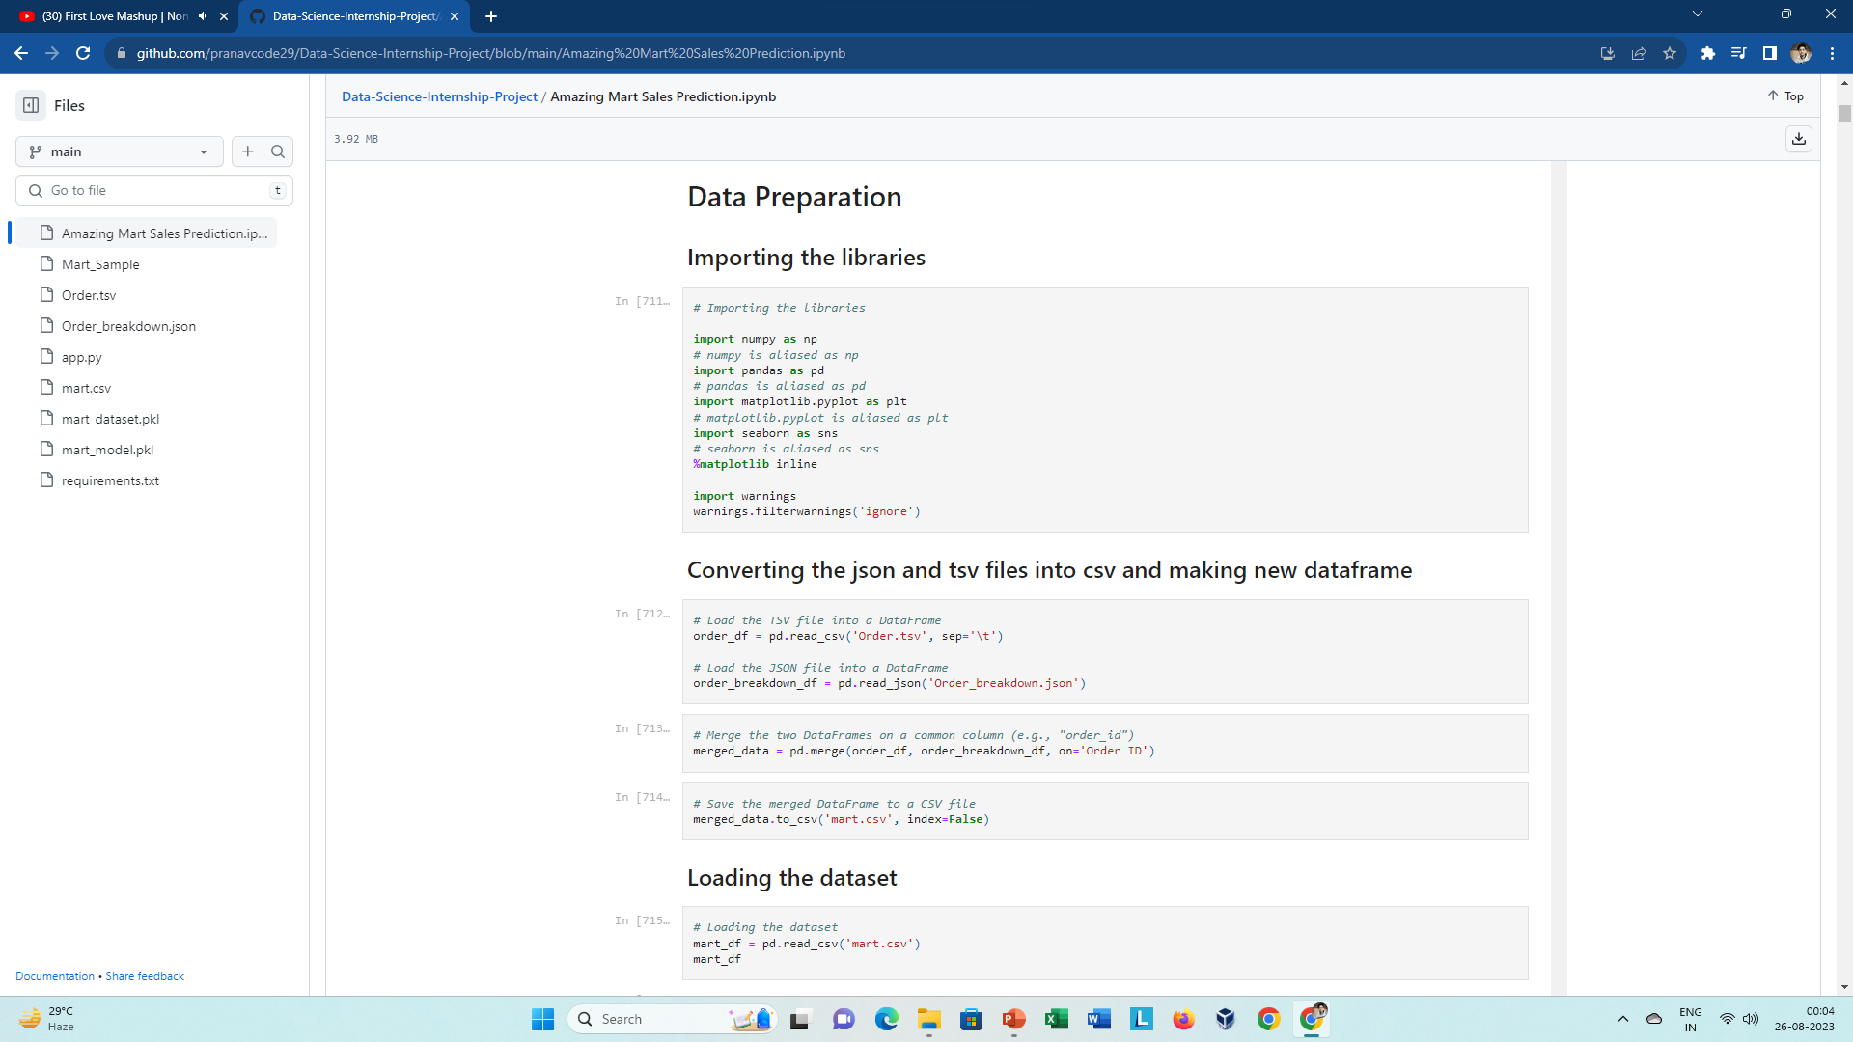
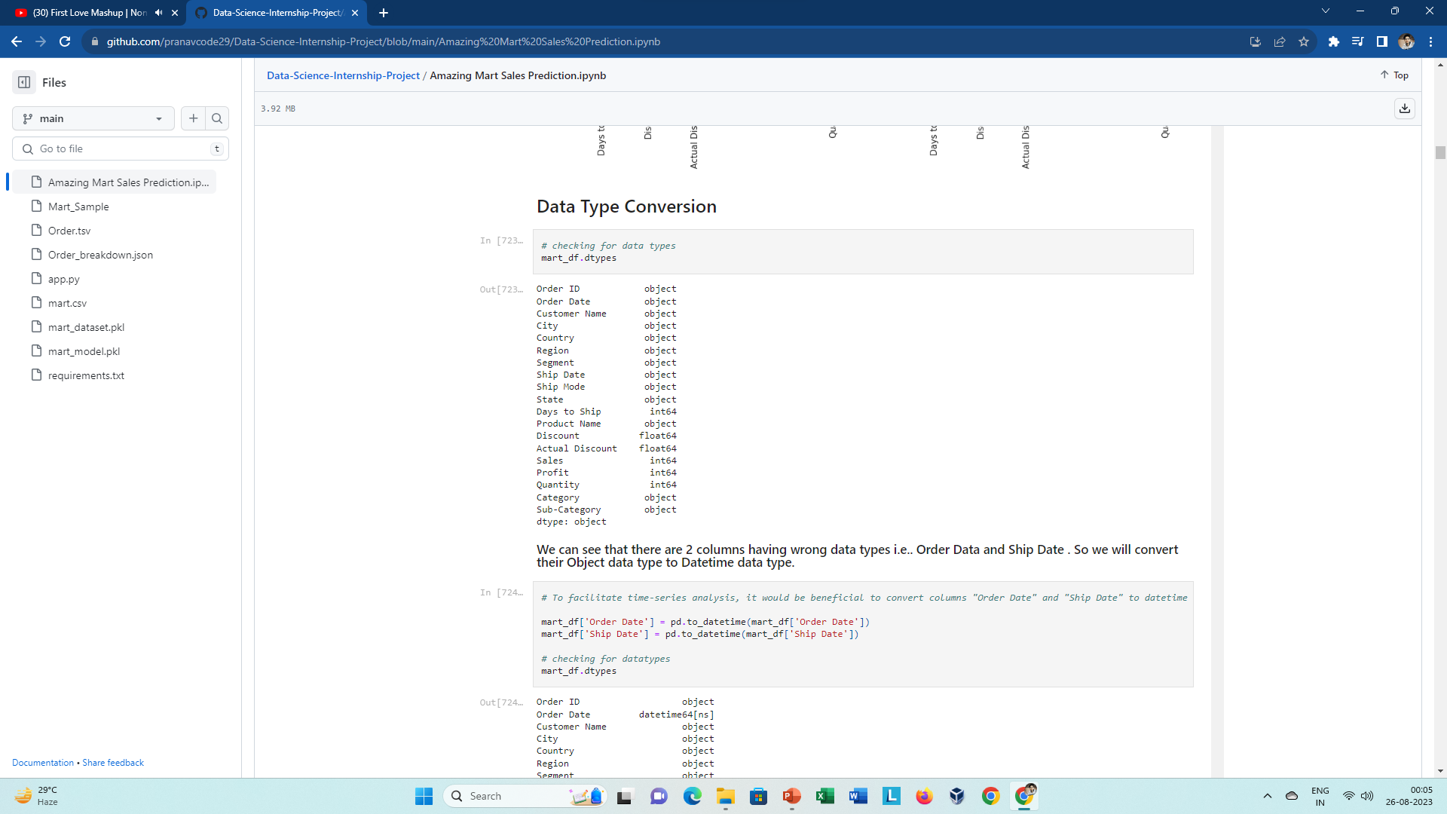
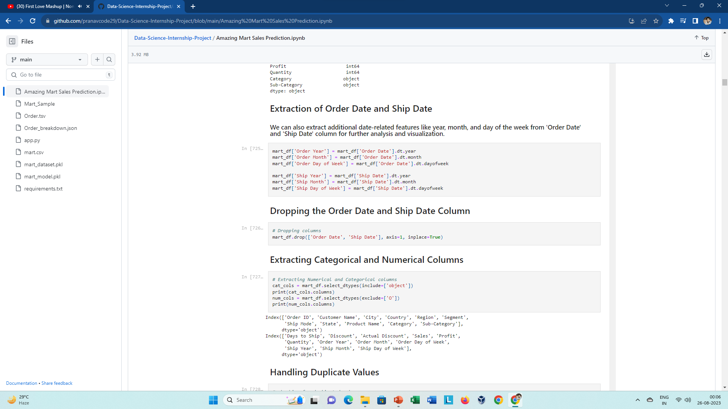
Data Cleaning and Data Preprocessing Steps
In this Project I have given one tsv file and one Json file, which we have to convert into csv format. Also, in our data there are 2 column with wrong data types i.e.. ‘Order Date’ and ‘Ship Date’, which we must convert into them into their respective data types. In this dataset I have performed basic data cleaning and data preprocessing like Handling Duplicate Values , Data Types Conversion, also finding outliers in sales, profit and actual discount column using boxplot and then removing such outliers using IQR method. I have also done Extraction of date from ‘Order Date’ and ‘Ship Date’ Column columns for better understanding of dataset. After performing all these steps, now data is ready to work for ml modelling. As a conclusion I can say, these final modifications will allow us to easily and effectively analyze the data in the following steps of the project.

Slide 16
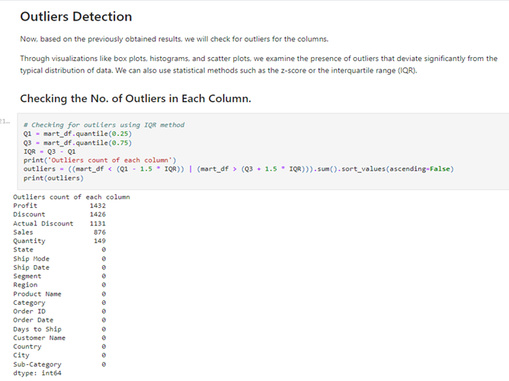
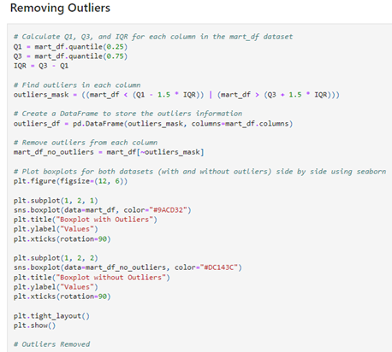
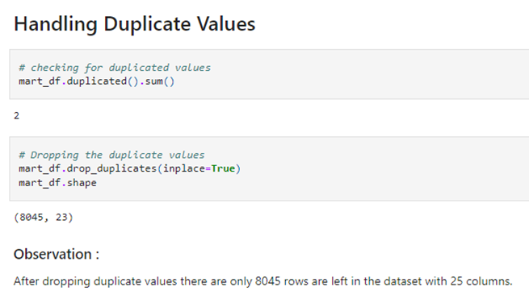
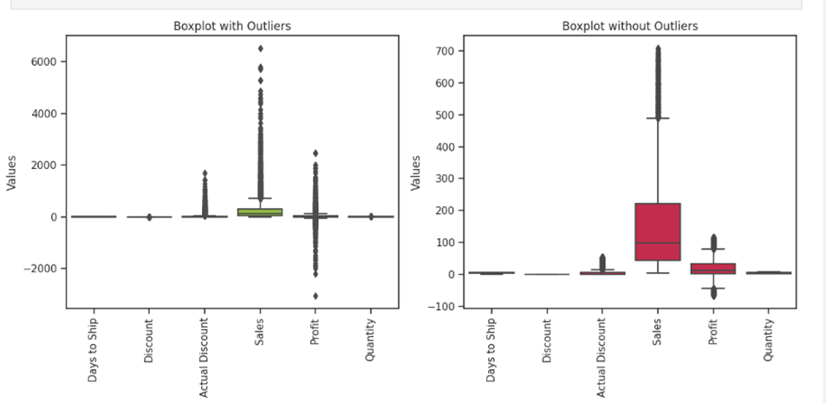

Data Cleaning and Data Preprocessing steps

Slide 17



ML Modeling
In this first I have converted all the categorical columns into numerical columns using label encoder() function which help dataset to work smoothly. Then, selected dependent and independent feature and then I Split the dataset into training and testing data, where 25 % of data I choose for testing . Now the 75 % of the training data helps to predict the sales by applying its result into testing data.

Slide 18


ML Modeling
Created a function to evaluate Regression Evaluation Metrics , Model Score where It gives the R2 score which defines the best model means the more the R2 score is the best the model works.
Showing Best Model
Imported some Important libraries.
In this I have build 8 Regression models…
Linear Regression
Lasso Regression
Ridge Regression
Knn Regressor
DecisionTree Regressor
Random Forest Regressor
AdaBoost Regressor
XGBoost Regressor
The best model from all the models is XGBoost Regressor which gave 86 % accuracy which is more than any other models.

Slide 19



ML Modeling
Saving and loading the best model using pickle library .

Slide 20


Deployment of ML Models using Streamlit

Slide 21




In the final step of the project, I created a Streamlit app for predicting the sales of the mart. I utilized the Streamlit library to build an interactive and user-friendly application that could provide instant predictions based on the input data. The app was titled “Mart Sales Prediction" and had a user-friendly interface that consisted of select boxes for 13 columns: City, Country, Region, Segment, Ship Mode, State, Days to Ship, Product Name, Discount, Actual Discount, Quantity, Category and Sub-Category. After the user inputs the required data, it generate the prediction of the Mart Sales, which was calculated using the saved machine learning model from the previous step. This Streamlit app was an effective tool that allowed users to easily predict the sales of the ‘Amazing Mart’ and make informed decisions.

Slide 22
Conclusion
In conclusion, this data science project aimed at predicting the sales of the mart based on several factors such as the Product Name, Category, Sub-Category, Segment, Ship Mode, Days to Ship, Country, state, City, Quantity and Discount . Through the various steps of data cleaning, exploratory data analysis, and model building, we were able to build a highly accurate XGBoost Regressor model with an R2 Score of over 86%. The final step of deploying the model into a Streamlit app made it easy for users to access and generate predictions instantly. However, it is important to note that the accuracy of the model could be improved further by incorporating additional information such as the Price, and other relevant factors. Nevertheless, the results of this project demonstrate the power of machine learning in providing valuable insights and predictions in the Supermarket Zone.

Slide 23
References
Tools Used : MS Excel, Jupyter Notebook, Python, NumPy, Pandas, Matplotlib, Seaborn, Scikit Learn, Streamlit.
GitHub link : Internship Project Github link
Streamlit Link : Streamlit App link : Sales Prediction

